Slide 1
User scenarios Functional and Technical Requirements, System Architecture (WP2)
Israel Koffman (RunEL) - WP 2 & WP 5 Leader

Slide 2
User Scenarios, Functional and Technical Requirements, System Architecture - Summary and Progress
The goal of WP 2 is to derive the technical requirements and specifications of the overall OPTI 6G system and the different components of the hybrid Photonic-Microwave Cell free Network.
Following the definition of the proposed solution specifications and requirements, the team proceeded with the detailed design of the Optical Domain Cell Free Networks that will be tested in the laboratory environment. In parallel the team is developing a comprehensive testing and verification methodology of the different KPI that will be measured and analysed in the lab tests.
WP2 delivered D2.1, D2.2 and D2.3 on time

Slide 3
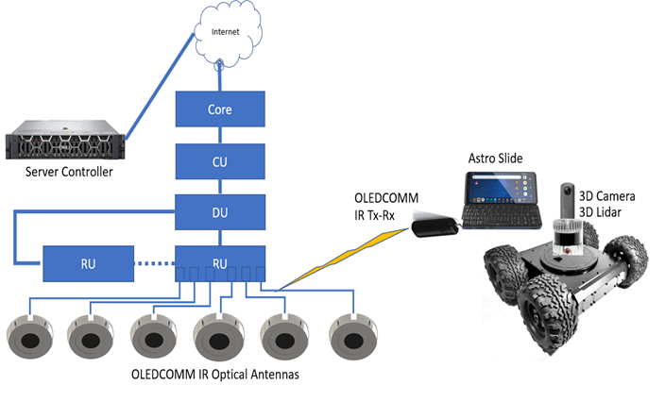
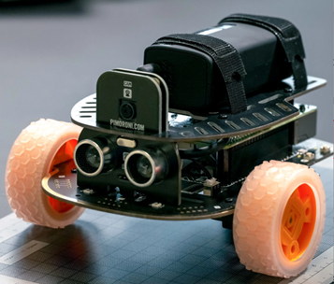
Use Case Descriptions
Factory 4.0, Smart Warehouses, Indoor Coverage
Related to Task: Task 2.1 OWC Cell Free Network Use Cases and User, Functional and Technical Requirements
Related to deliverable: D2.1:OWC Cell Free Network Use Cases and User, functional and Technical Requirements
Brief introduction: 5G ACIA has identified mobile robots/AGVs use cases which represent mobile systems on a shop floor.
In factory of the future, AGVs play an important role and take care of such tasks as driverless and autonomous transport of material and goods from and to production lines. focus on two important features of AGVs:
Video processing off loading from an AGV camera to the neighbor edge computing node with high requirements on data rate (>500 Mbps),
Localization of an AGV in different scenarios with high requirements on accuracy for the localization (< 1 cm).
Practical importance:
Show how AGV can be efficiently navigated in factory and warehouse environments
Contributions and novelties:
•Contribution: cm localisation accuracy for indoor and outdoor locations
•Novelty: AGV Navigation system will make it applicable in environments where dangerous flammable materials are being handled.
Pimoroni AGV
Lynxmotion Rugged Wheeled AGV

Slide 4
KPI and KVI Requirements
KPI | Offloading of the PLC Control Function to the Edge | Smart Transportation Vehicles |  | Material Handling
 |  | Localization | Video Processing Offloading
Round trip time (sensor to controller to actuator) | < 10 ms (250 µs - 10 ms) | 50 ms | 50 ms | 10 ms
Reliability (packet error rate within latency reqs.) | 10⁻⁸ | 10-6 | 10-4 | 10⁻⁶
Data rate | kbit/s-Mbit/s | kbit/s-Mbit/s | Mbit/s-Gbit/s | Mbit/s-Gbit/s
Packet size | up to 1500 Byte | 20-50 Byte | 1500 Byte | >200 Byte
Covered distance (from an access point) | within the facility | within the facility | within the facility | <100 m
Movement speed of the user | < 1 m/s | <10 m/s | <10 m/s | < 3 m/s
Time critical handover support | Yes | Yes | Yes | No
User equipment density | 0.33-3 per m² | 0.001 per m2 | 0.001 per m2 | 0.03-0.02 per m²
Energy efficiency (user equipment battery lifetime) | n/a | n/a | n/a | 1 day
Location detection accuracy | <50 cm | 1 cm | n/a | < 1 cm
Service availability | 99.999 % | 99.999 % | 99.999 % | 99.9 %
Slice configuration / reconfiguration time | 1 s | 1 s | 1 s | 1 s
Type of KVIs | KVI | Offloading of the PLC Control Function to the Edge | Smart Transportation Vehicles |  | Material Handling
 |  |  | Localization | Video Processing Offloading
Environmental | Carbon Footprint Reduction | 1% | 2% |  | 2%
 | Energy Efficiency | 0% | 10% |  | 20%
 | Resource Consumption | 5% | 5% |  | 10%
Social | Employee Safety and Well-being | 100% | 100% |  | 100%
 | Skills Development | AI + Programmable Control | AI + AGV |  | AI + Robot
 | Job Creation vs. Automation Balance | 50:50 | 50:50 |  | 50:50
 | Community Engagement and Impact | High | High |  | Very High
Economic | Productivity Growth | 100% | 100% |  | 100%
 | Market Share | Disruptive technology enhancing existing solutions | Disruptive technology enhancing existing solutions |  | Disruptive technology enhancing existing solutions
 | Cost Efficiency | 20% Reduction in personal costs | 90% Reduction in personal costs |  | 90% Reduction in personal costs
 | Supply Chain Resilience | 50% enhanced | 50% enhanced |  | 50% enhanced

Slide 5
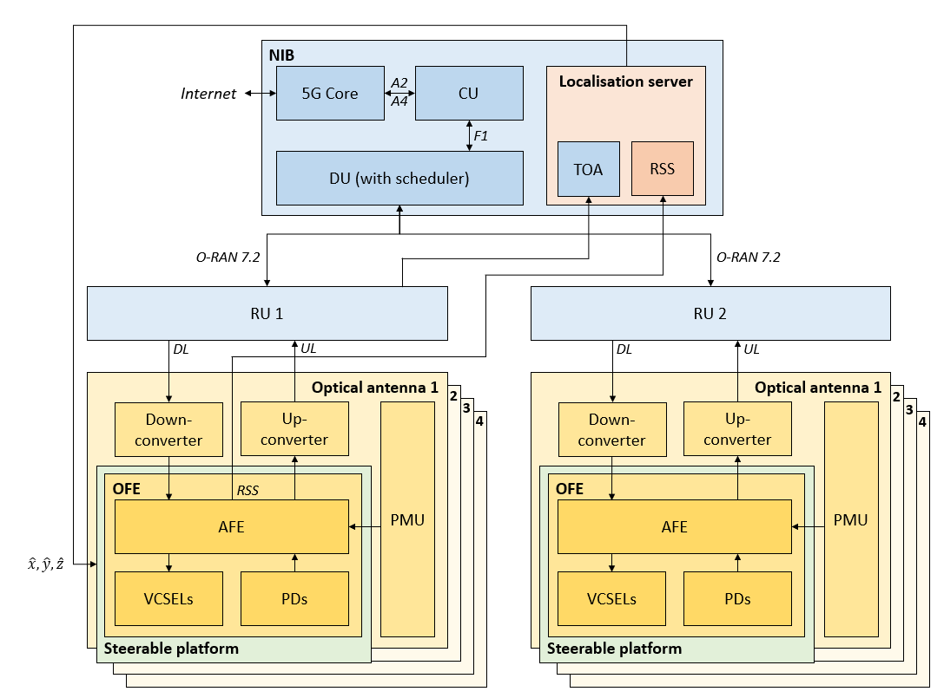
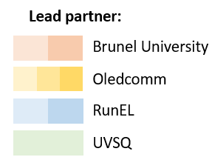
OPTI-6G Cell-Free Network System Architecture (Infrastructure Side)
Related to Task: Task 2.2 - Design of Optical Communication and Sensing Architecture
Related to deliverable: D2.2 - OWC Cell-Free Architecture
Brief introduction: Full architecture of the OPTI-6G system (infrastructure side).
Practical importance: Architecture on which the OPTI-6G demonstrator will be based.
Contributions and novelties:
  Contribution : OPTI-6G Cell-Free Network System Architecture.
  Novelty: Use of 5G protocols and components in the optical domain to support multi-Gbps data transmission along with accurate UE positioning via multiple optical wireless localisation methods (RSS, TDOA, beamsteering-based).

Slide 6
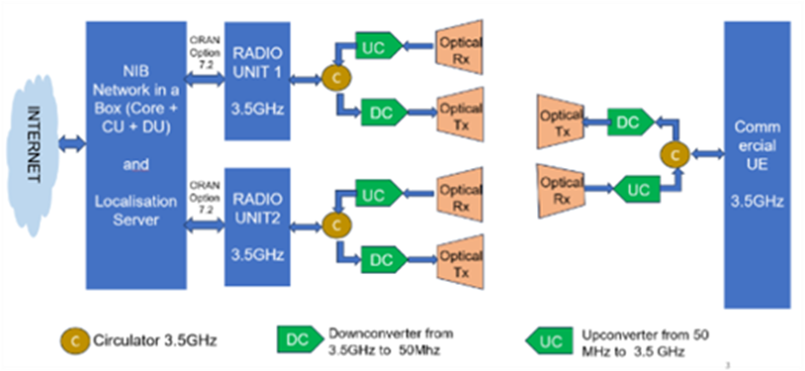
Communication Test-bed
Related to Task: Task 2.3 Testing and KPI Verification Methodology
Related to deliverable: D2.3 OWC Cell Free Network Testing and KPI Verification Methodology
Brief introduction: This deliverable presents the experimental testbed designed to evaluate the communication performance of the Optical Wireless Communication (OWC) link and its integration into a 5G Radio Access Network (RAN) operating in a Cell-Free Network (CFN) configuration.
Practical importance: This testbed is crucial for validating the practical feasibility of the hybrid system. It allows for the measurement of key communication KPIs such as throughput, latency, and handover performance, which are essential to prove the system’s viability for real-world, high-reliability applications
Contributions and novelties:
Contribution : The testbed consists of a 5G “Network in a Box” (Core, CU, DU), two Radio Units (RUs) to enable cell-free operation, and a commercial 5G User Equipment (UE). Each RU and the UE are interfaced with the OWC subsystem via circulators and up/down converters that translate signals between 3.5 GHz and a 50 MHz baseband frequency for optical transmission.
Novelty: The key novelty of this testbed is its cell-free configuration for an OWC system. It is specifically designed to assess the performance of a user moving between the coverage areas of two separate optical access points. This will provide one of the first experimental validations of handover performance in a cell-free OWC network, aiming to demonstrate near-zero packet loss and microsecond-level handover latency
Notes:
Emmanuel

Slide 7
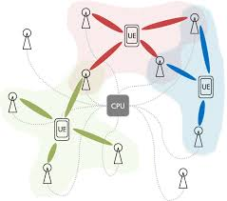
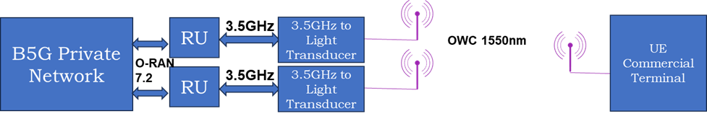
Cell Free Test-bed
RU
Cell Free Network
Core + CU + DU
RU
Core + CU + DU
Notes:
Israel

Slide 8
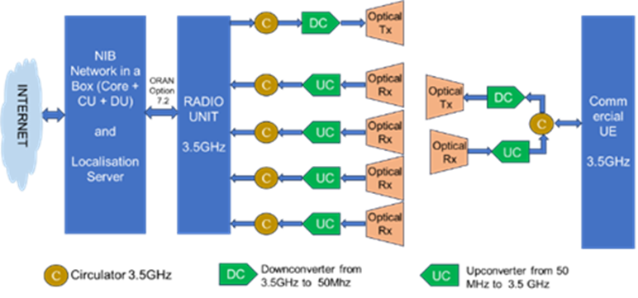
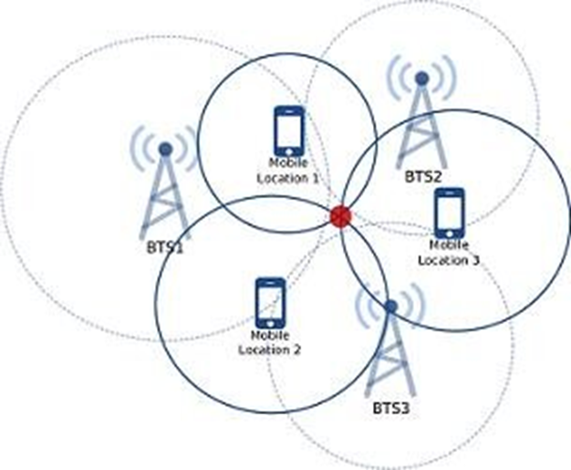
TDoA Localisation Architecture
Related to Task: Task 2.3 Testing and KPI Verification Methodology
Related to deliverable: D2.3 OWC Cell Free Network Testing and KPI Verification Methodology
Trilateration Location Technique
Notes:
RunEL

Slide 9
Dedicacted
Q&A session
30 minutes

